Slide 1
Motor Control and Reinforcement Learning
Computational Cognitive Neuroscience
Randall O’Reilly

Slide 2
Learning Rules Across the Brain
Learning Signal
Dynamics
Area | Reward | Error | Self Org | Separator | Integrator | Attractor
Primitive Basal Ganglia | +++ | - - - | - - - | ++ | - | - - -
Cerebellum | - - - | +++ | - - - | +++ | - - - | - - -
Advanced Hippocampus | + | + | +++ | +++ | - - - | +++
Neocortex | ++ | +++ | ++ | - - - | +++ | +++
+ = has to some extent … +++ = defining characteristic – definitely has
- = not likely to have … - - - = definitely does not have

Slide 3
Primitive, Basic Learning..
Learning Signal
Dynamics
Area | Reward | Error | Self Org | Separator | Integrator | Attractor
Primitive Basal Ganglia | +++ | - - - | - - - | ++ | - | - - -
Cerebellum | - - - | +++ | - - - | +++ | - - - | - - -
Reward & Error = most basic learning signals
(self organized learning is a luxury..)
Simplest general solution to any learning problem is a
lookup table = separator

Slide 4
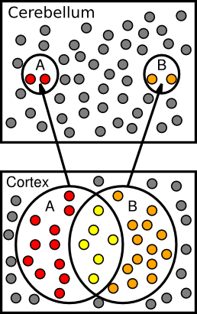
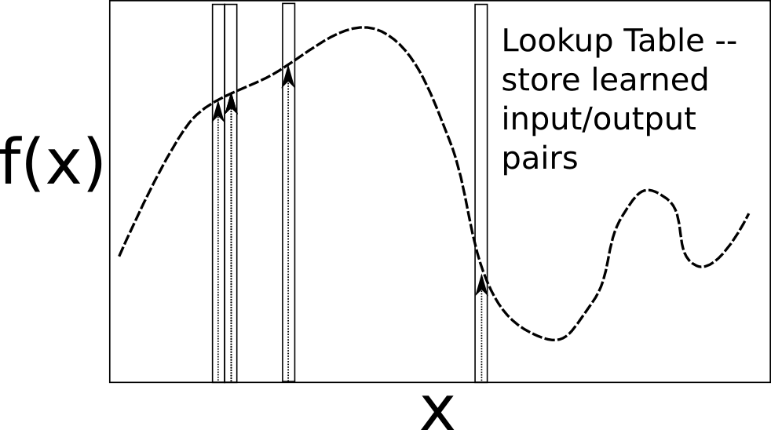
Lookup Table & Pattern Separation

Slide 5
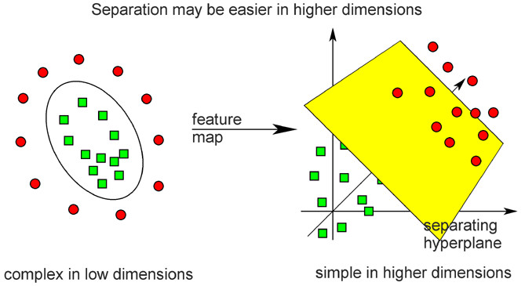
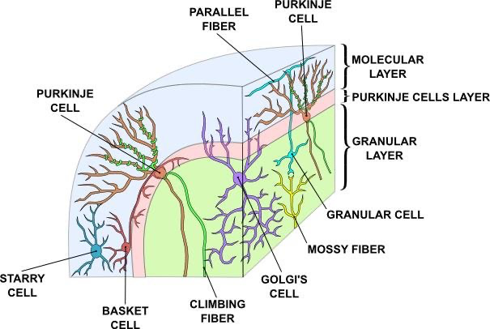
Cerebellar Error-driven Learning
Cerebellum =
Support Vector Machine
Granule cells = high-dimensional encoding (separation)
Purkinje/Olive = delta-rule error-driven learning
Classic ideas from Marr (1969) & Albus (1971)
Notes:
Time delayed weight changes
Can’t do backprop – need to have a generic all-purpose good-enough representation
First wave of computational modelers got the 1st principal component right on *everything*

Slide 6
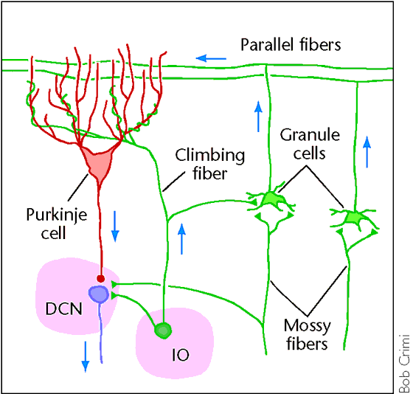
Cerebellum is Feed Forward
Feedforward circuit:
Input (PN) -> granules -> Purkinje -> Output (DCN)
Inhibitory interactions – no attractor dynamics
Key idea: does delta-rule learning bridging small temporal gap:
S(t-100) -> R(t)
^ Error(t+100)

Slide 7
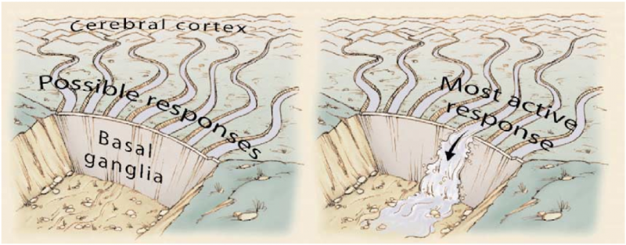
Basal Ganglia and Action Selection

Slide 8
Two Competing Pathways

Slide 9
Positive dopamine reinforces Go!

Slide 10
Negative dopamine reinforces No Go!

Slide 11
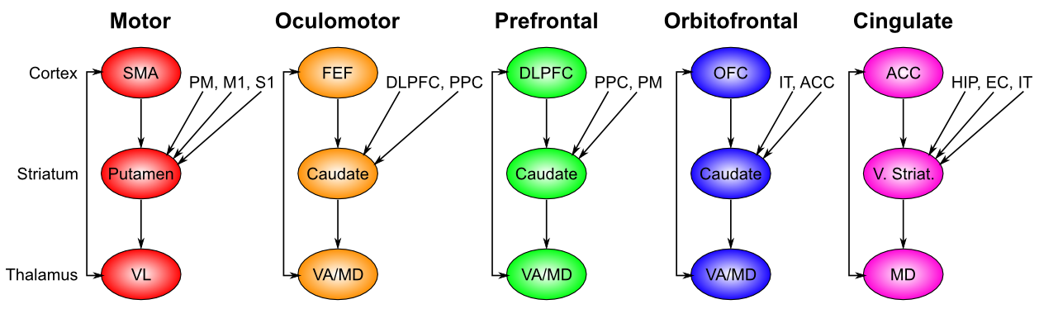
Basal Ganglia: Action Selection
(Alexander, de Long & Strick, 1986)
Selects motor and “cognitive” actions across frontal areas

Slide 12
Chain of Command..

Slide 13
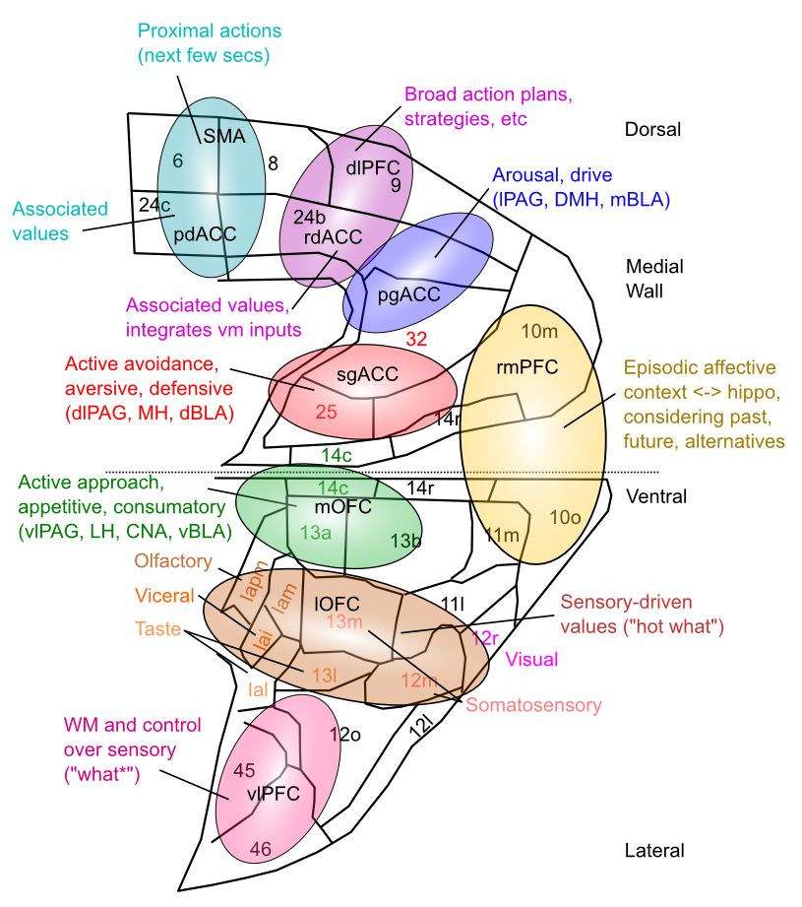
Medial Frontal Map of Values

Slide 14
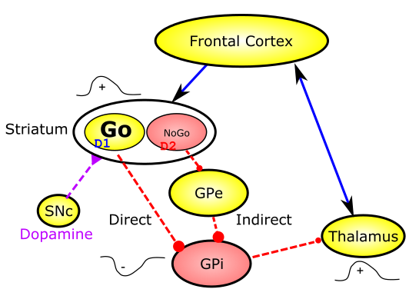
Release from Inhibition

Slide 15
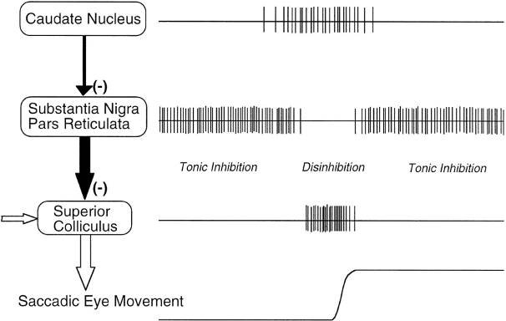
Release from Inhibition

Slide 16
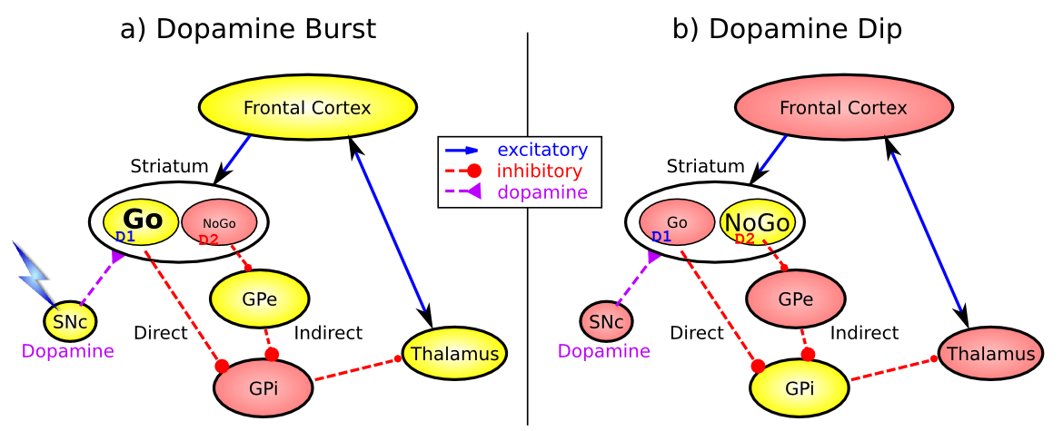
Basal Ganglia Reward Learning (Frank, 2005…; O’Reilly & Frank 2006)
Feedforward, modulatory (disinhibition) on cortex/motor
(same as cerebellum)
Co-opted for higher level cognitive control -> PFC

Slide 17
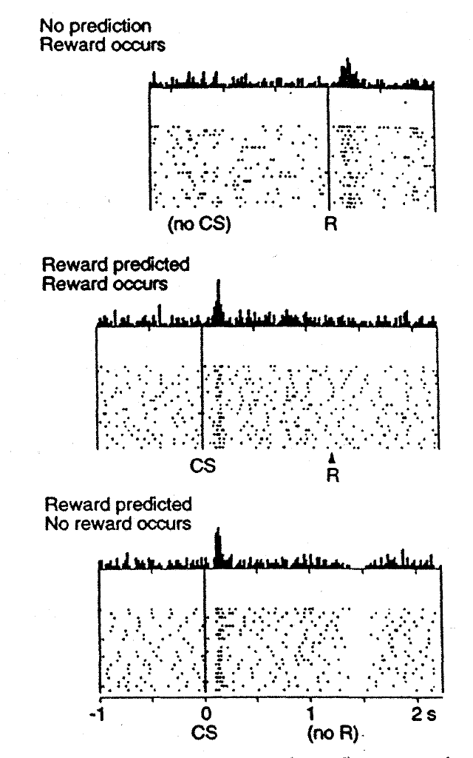
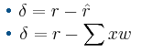
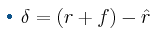
Reinforcement Learning: Dopamine
Rescorla-Wagner / Delta Rule:
But no CS-onset firing – need to
Anticipate the future!
CS-onset = future reward = f

Slide 18
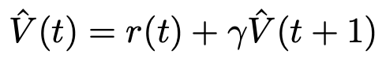
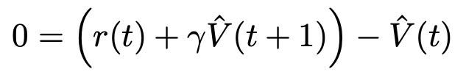
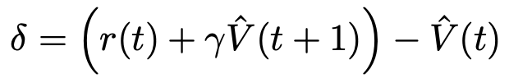
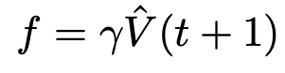
Temporal Differences Learning
<- this is the future!

Slide 19
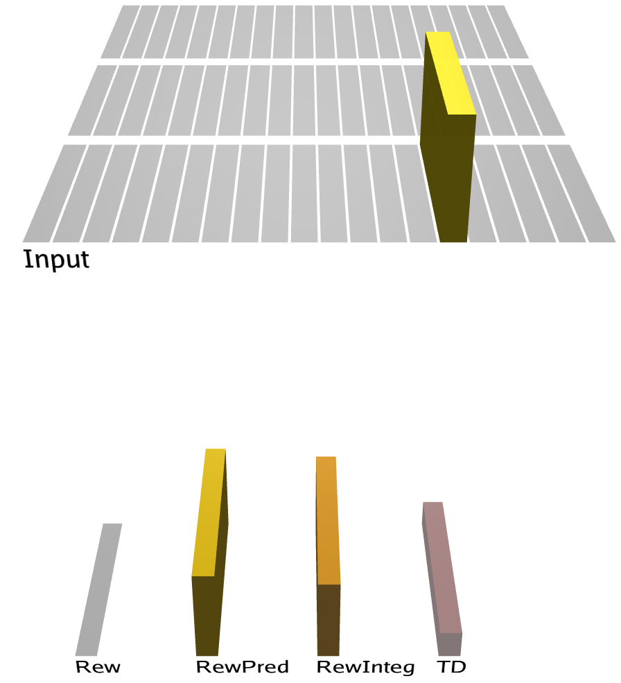
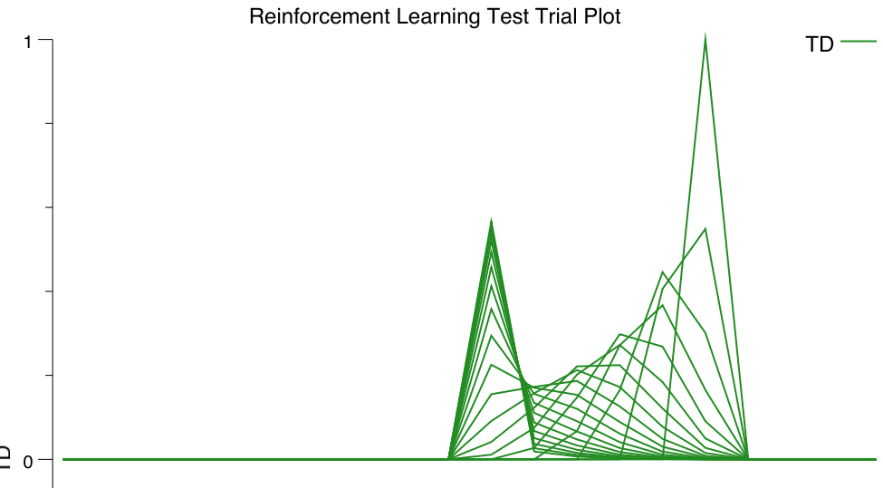
Network Implementation

Slide 20
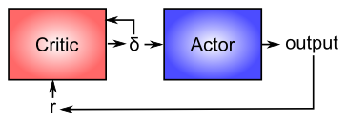
Actor - Critic

Slide 21
Biology of Dopamine

Slide 22
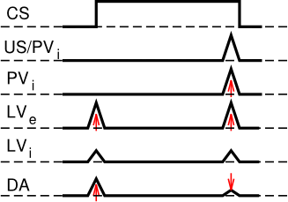
Biology of Dopamine: PVLV

Slide 23
Biology of Dopamine
Mollick et al, in press

Slide 24
BG + Cerebellum Capacities
Learn what satisfies basic needs, and what to avoid (BG reward learning)
And what information to maintain in working memory (PFC) to support successful behavior
Learn basic Sensory -> Motor mappings accurately (Cerebellum error-driven learning)
Sensory -> Sensory mappings? (what is going to happen next..)

Slide 25
BG + Cerebellum Incapacities
Generalize knowledge to novel situations
Lookup tables don’t generalize well..
Learn abstract semantics
Statistical regularities, higher-order categories, etc
Encode episodic memories (specific events)
Useful for instance-based reasoning
Plan, anticipate, simulate, etc..
Requires robust working memory

